Slide 1
Face Recognition using
PCA (Eigenfaces) and LDA (Fisherfaces)
Slides adapted from Pradeep Buddharaju

Slide 2
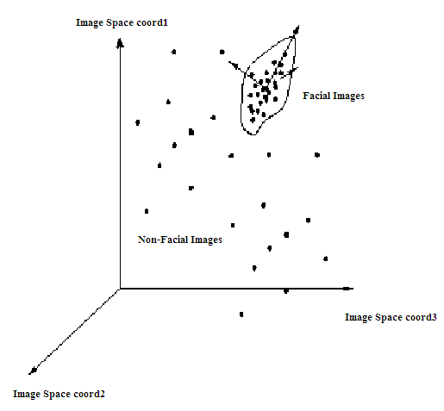
Principal Component Analysis
A N x N pixel image of a face, represented as a vector occupies a single point in N²-dimensional image space.
Images of faces being similar in overall configuration, will not be randomly distributed in this huge image space.
Therefore, they can be described by a low dimensional subspace.
Main idea of PCA for faces:
  To find vectors that best account for variation of face images in entire image space.
  These vectors are called eigen vectors.
  Construct a face space and project the images into this face space (eigenfaces).

Slide 3
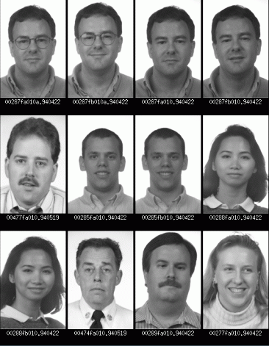
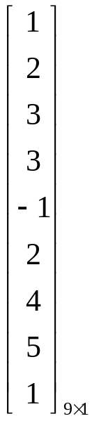
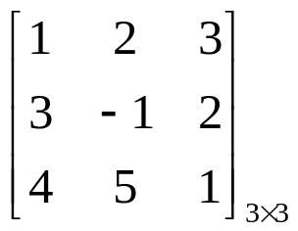
Image Representation
Training set of m images of size N*N are represented by vectors of size N²
x₁,x₂,x₃,…,x_{M}
Example

Slide 4
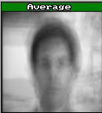
Average Image and Difference Images
The average training set is defined by
μ= (1/m) ∑^{m}_{i=1} x_{i}
Each face differs from the average by vector
    r_{i} = x_{i} – μ

Slide 5
Covariance Matrix
The covariance matrix is constructed as
C = AA^{T} where A=[r₁,…,r_{m}]
Finding eigenvectors of N² x N² matrix is intractable. Hence, use the matrix A^{T}A of size m x m and find eigenvectors of this small matrix.
Size of this matrix is N² x N²

Slide 6
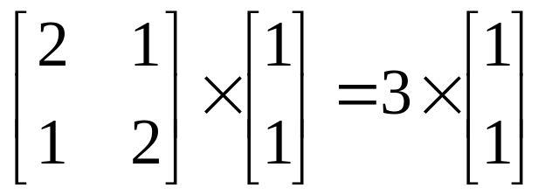
Eigenvalues and Eigenvectors - Definition
If v is a nonzero vector and λ is a number such that
Av = λv, then
v is said to be an eigenvector of A with eigenvalue λ.
Example
λ
(eigenvalues)
A
v
(eigenvectors)

Slide 7
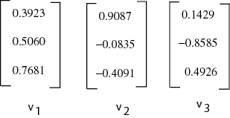
Eigenvectors of Covariance Matrix
The eigenvectors v_{i} of A^{T}A are:
Consider the eigenvectors v_{i} of A^{T}A such that
A^{T}Av_{i} = μ_{i}v_{i}
Premultiplying both sides by A, we have
AA^{T}(Av_{i}) = μ_{i}(Av_{i})

Slide 8
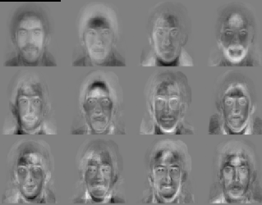
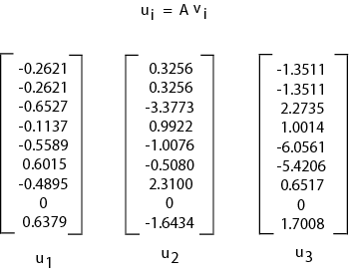
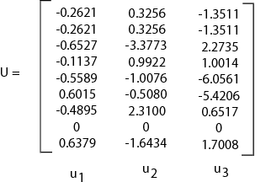
Face Space
The eigenvectors of covariance matrix are
u_{i} = Av_{i}
Face Space
u_{i} resemble facial images which look ghostly, hence called Eigenfaces

Slide 9
Projection into Face Space
A face image can be projected into this face space by
p_{k} = U^{T}(x_{k} – μ) where k=1,…,m

Slide 10
Recognition
The test image x is projected into the face space to obtain a vector p:
p = U^{T}(x – μ)
The distance of p to each face class is defined by
Є_{k}² = ||p-p_{k}||²; k = 1,…,m
A distance threshold Ө_{c}, is half the largest distance between any two face images:
Ө_{c} = ½ max_{j,k} {||p_{j}-p_{k}||}; j,k = 1,…,m

Slide 11
Recognition
Find the distance Є between the original image x and its reconstructed image from the eigenface space, x_{f},
Є² = || x – x_{f} ||² , where x_{f} = U * x + μ
Recognition process:
  IF Є≥Ө_{c}
  then input image is not a face image;
  IF Є<Ө_{c} AND Є_{k}≥Ө_{c} for all k
  then input image contains an unknown face;
  IF Є<Ө_{c} AND Є_{k}*=min_{k}{ Є_{k}} < Ө_{c}
  then input image contains the face of individual k*

Slide 12
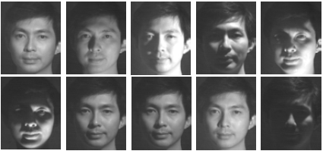
Limitations of Eigenfaces Approach
Variations in lighting conditions
  Different lighting conditions for enrolment and query.
  Bright light causing image saturation.
Differences in pose – Head orientation
  - 2D feature distances appear to distort.
Expression
  - Change in feature location and shape.

Slide 13
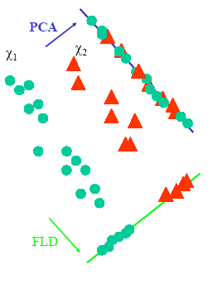
Linear Discriminant Analysis
PCA does not use class information
  PCA projections are optimal for reconstruction from a low dimensional basis, they may not be optimal from a discrimination standpoint.
LDA is an enhancement to PCA
  Constructs a discriminant subspace that minimizes the scatter between images of same class and maximizes the scatter between different class images

Slide 14
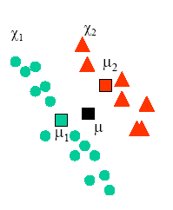
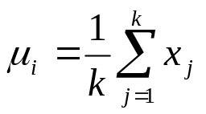
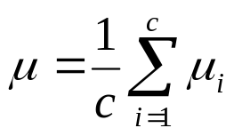
Mean Images
Let X₁, X₂,…, X_{c} be the face classes in the database and let each face class X_{i}, i = 1,2,…,c has k facial images x_{j}, j=1,2,…,k.
We compute the mean image μ_{i} of each class X_{i} as:
Now, the mean image μ of all the classes in the database can be calculated as:

Slide 15
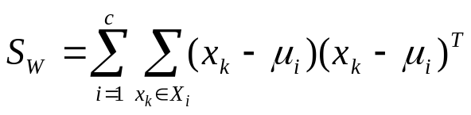
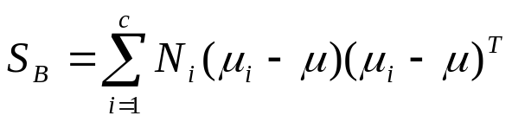
Scatter Matrices
We calculate within-class scatter matrix as:
We calculate the between-class scatter matrix as:

Slide 16
Multiple Discriminant Analysis
We find the projection directions as the matrix W that maximizes
This is a generalized Eigenvalue problem where the columns of W are given by the vectors w_{i} that solve

Slide 17
Fisherface Projection
We find the product of S_{W}⁻¹ and S_{B} and then compute the Eigenvectors of this product (S_{W}⁻¹ S_{B}) - AFTER REDUCING THE DIMENSION OF THE FEATURE SPACE.
Use same technique as Eigenfaces approach to reduce the dimensionality of scatter matrix to compute eigenvectors.
Form a matrix W that represents all eigenvectors of S_{W}⁻¹ S_{B} by placing each eigenvector w_{i} as a column in W.
Each face image x_{j} ∈ X_{i} can be projected into this face space by the operation
      p_{i} = W^{T}(x_{j} – μ)

Slide 18
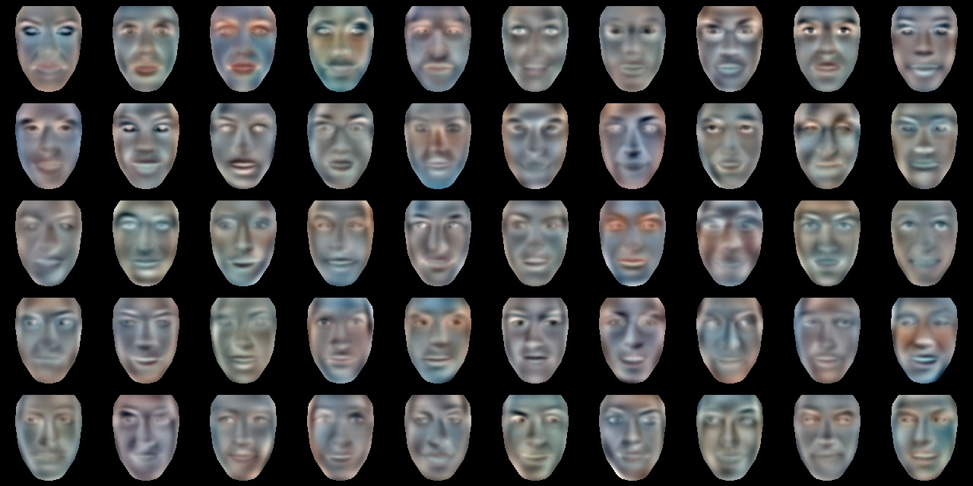

Slide 19
Testing
Same as Eigenfaces Approach

Slide 20
References
Turk, M., Pentland, A.: Eigenfaces for recognition. J. Cognitive Neuroscience 3 (1991) 71–86.
Belhumeur, P.,Hespanha, J., Kriegman, D.: Eigenfaces vs. Fisherfaces: recognition using class specific linear projection. IEEE Transactions on Pattern Analysis and Machine Intelligence 19 (1997) 711–720.

